Slide 1
encryption using transposition techniques

Slide 2
Abstract
The ciphertext is generated from the plain text by using an encryption process in this method the message is generated like a code the sender give some input(keys) so that the message Shaffle its positions and the user can repeat this process as many times he can and as many times he does this the plane text turn in very complex to decode

Slide 3
Introduction
Today, Ciphertex is a leader in data security software and integrated hardware-based AES 256-bit encryption and RAID storage technologies. The evidenced by the experiments conducted in this study based on the measurement of PSNR, MSE, SSIM, entropy and the encrypted image histogram

Slide 4
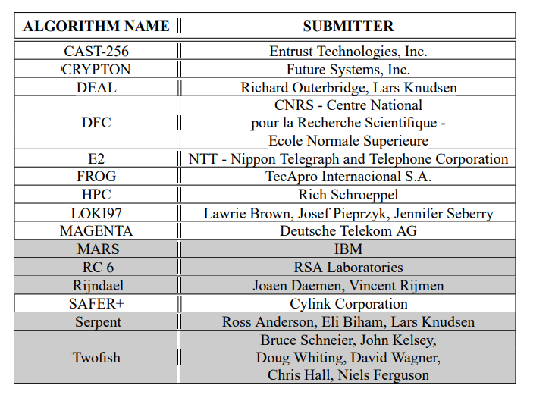
Literature review

Slide 5
All of the cryptographic algorithms we have looked at so far have some problems. The earlier ciphers can be broken with ease on modern computation systems. The DES algorithm was broken in 1998 using a system that cost about $250,000. It was also far too slow in software as it was developed for mid-1970’s hardware and does not produce efficient software code. Triple DES, on the other hand, has three times as many rounds as DES and is correspondingly slower. As well as this, the 64-bit block size of triple DES and DES is not very efficient and is questionable when it comes to securityThe National Institute of Standards and Technology (NIST) wanted to help in the creation of a new standard. However, because of the controversy that went with the DES algorithm, and the years of some branches of the U.S. government trying everything they could to hinder the deployment of secure cryptography this was likely to raise strong skepticism.

Slide 6
Methods
How to study encryption?
This anser is given by William Emmanuel Yu Chief Nerd. PHB and PHD.
Normally, I would advice you to take a class or short course as it is one of the fastest ways to learn cryptography.
This method is used for security purpose
. We have to give the plain text
. We create a matrix and insert the plain text into the matrix
.next we insert the keys and using this keys we get the cipertext

Slide 7
Results
Studying this project we get why encryption is used and how a plain text can be converted into ciphertext by studying we know how the researchers did hard work to develop this

Slide 8
Discussion
The result we get a secured code to create created to form the given plane text the size of the matrix can be encoder and decoder’s choice

Slide 9
Conclusion
Encryption is used to secure the data we can repeat this process n number of times

